Slide 1

Robot Operating system
Behavior Tree
Lecturer: Dr. Bui Ha Duc
Dept. of Mechatronics
Email: ducbh@hcmute.edu.vn

Slide 2

Decision making
Problem:
Given a situation and set of possible actions to execute, which of the possible actions is the best?

Slide 3
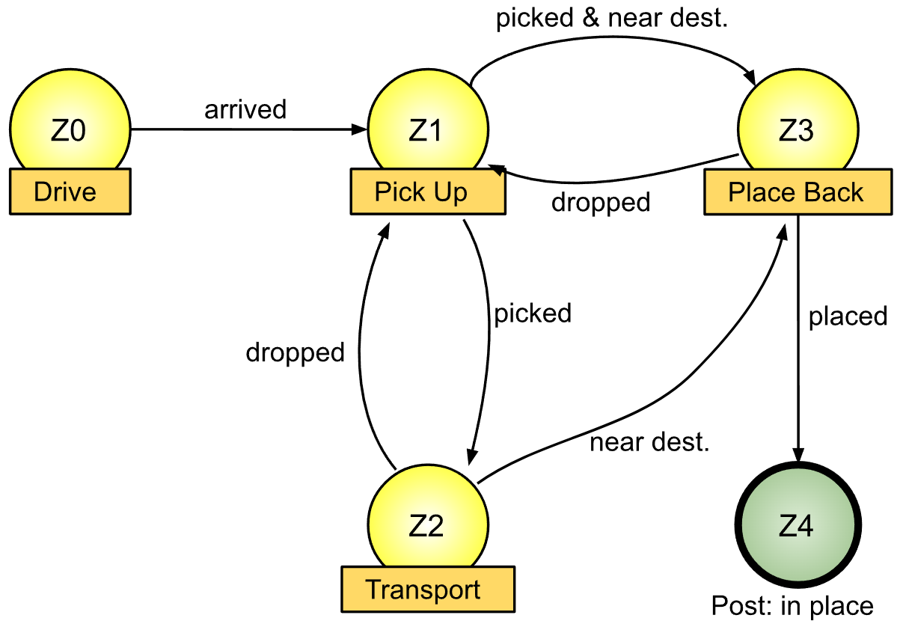
Task Switching Structure
Task Switching Structure is framework that decides which task to run given a set of available actions and changing environment conditions
  When a and what action do we switch
Traditional method: FSM – Finite State Machines
places the item at its destination
driving to the location of the item
transports the item to its destination
FSM Example for Cleaning robot

Slide 4
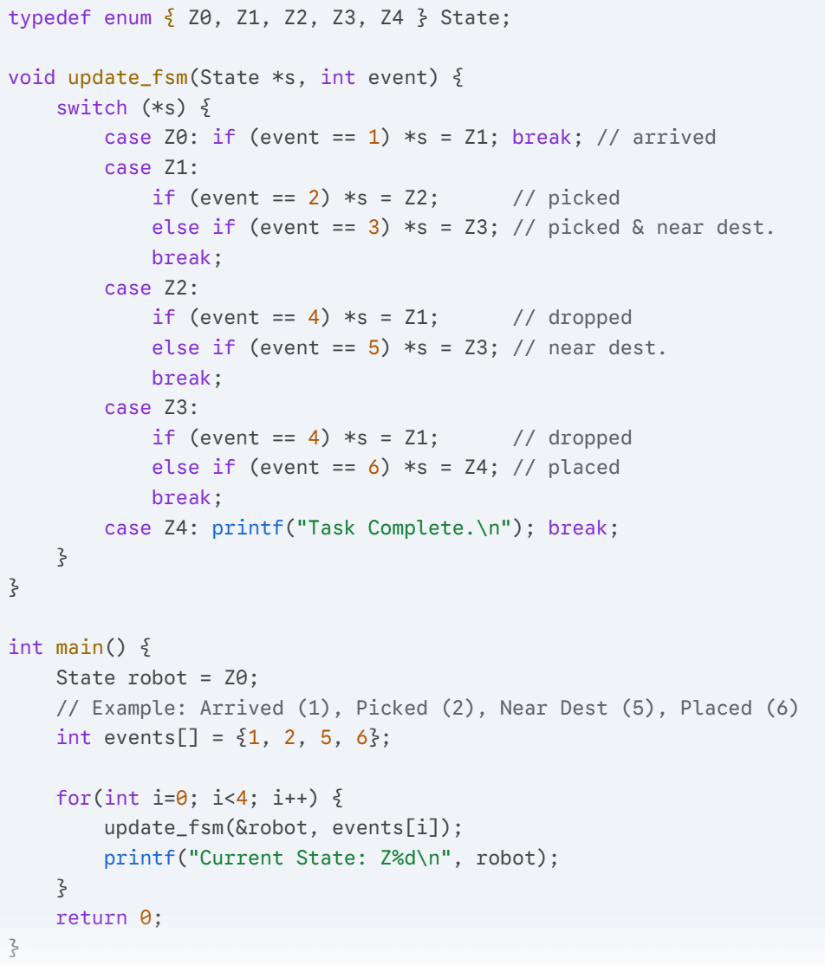
Task Switching Structure
FSMs lack modularity, become less effective as tasks grow more complex

Slide 5
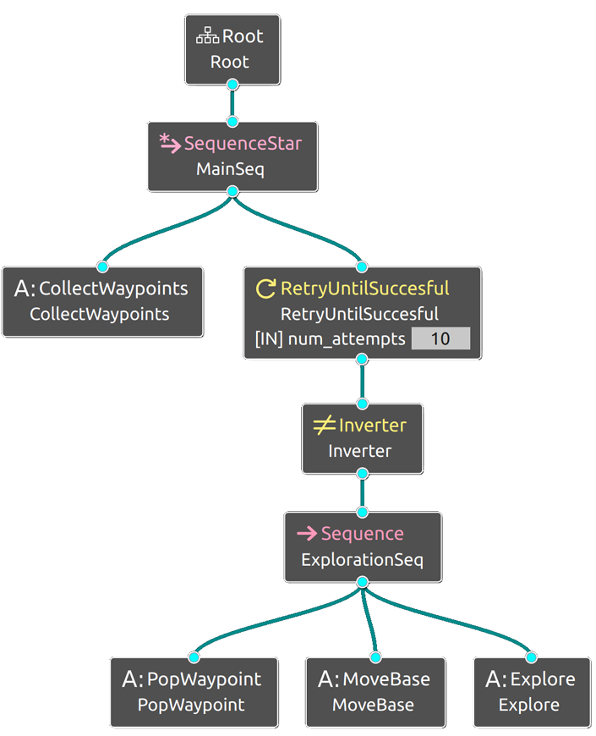
Introduction to Behavior Tree
Behavior Tree (BT) is a Task Switching structure
BT Advantages:
  Graphical representation: Easier to understand the overall decision process.
  Modularity: Sub-trees can be reused easily.
  Hierarchical structure: Actions exist on many levels of detail
  Reactivity: Re-evaluated frequently, allowing fast reactions.

Slide 6
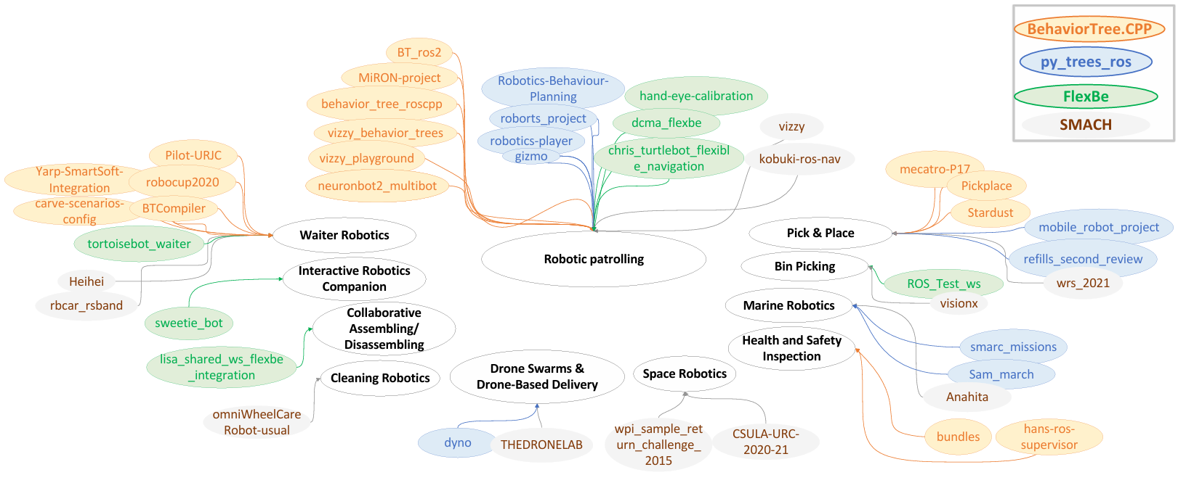
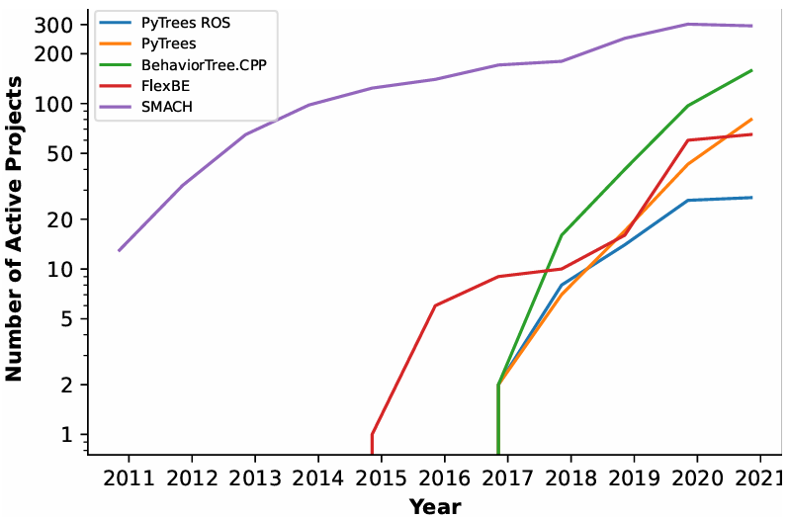
Introduction to Behavior Tree
Usage of Behavior Tree and State Machine in Robotics
Source: https://arxiv.org/pdf/2208.04211

Slide 7
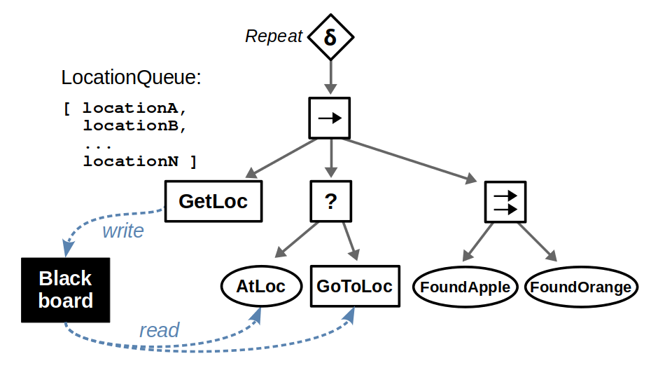
Components of BT
Root: the starting point of the execution
Start the Logic (“tick” signal)
Has 1 direct child, usually a control Node
Receives a status back from its child
  Success, Failure or Running
Pass status back to the main controller

Slide 8
Components of BT
Nodes: perform tasks
Types: Control, Decorator, Action and Condition
Nodes are define in C++ by users/developers
Node don't pass arguments to each other directly
Parent node can only see its direct child / children

Slide 9
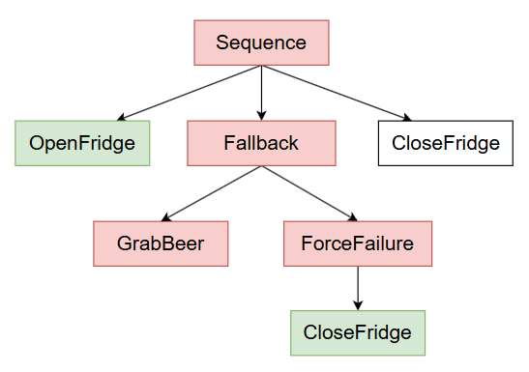
BT Nodes
Control Nodes – The Decision Makers
Can have one or more children
Return 3 status: Success, Failure, Running
Sequence Nodes (→): Runs children one by one, from left to right. If one fails, the whole sequence fails. It only succeeds if all children succeed.
Fallback Nodes (?): Runs children one by one, from left to right. If one succeeds, the node stops and returns success. It only fails if all children fail.

Slide 10
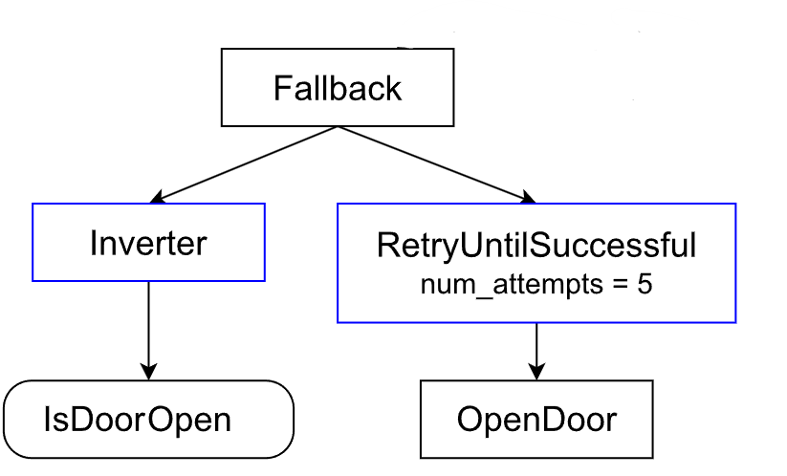
BT Nodes
Decorator Nodes – the Modifiers
Have exactly one child.
Change the child behavior
Inverter: Turns Success into Failure and vice versa
Repeater: Runs the child multiple times
Retry: Keeps ticking the child until it succeeds

Slide 11
BT Nodes
Leaf Nodes – the Doers
Have no child.
Leaf Nodes interact with the robot or the environment
Action Nodes: Perform an actual task
Condition Nodes: Check a state without changing anything

Slide 12
Components of BT
Blackboard: Shared memory space
Key – value database
Nodes are defined in C++ by users/developers
Nodes write and read values via Blackboard
Data Types: anything (Boolean, int, vector, vector3 …)

Slide 13
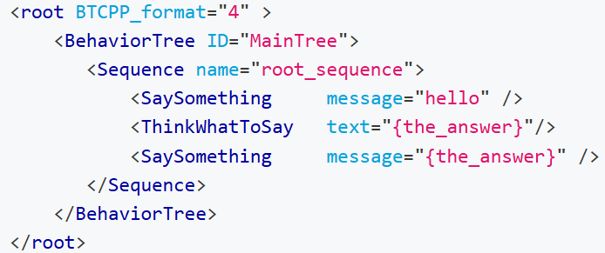
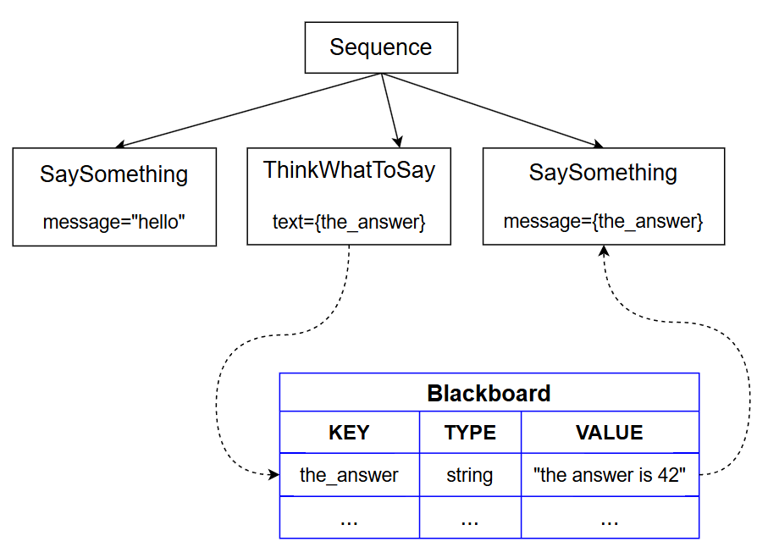
BT Blackboard and Ports
Input port can read an entry in the Blackboard
Output port can write into an entry in Blackboard

Slide 14
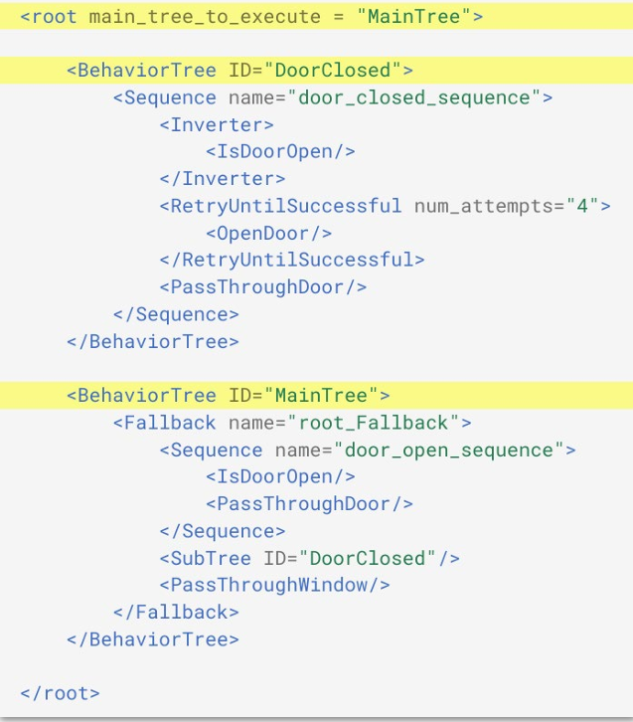





Implementing BT
BT (.xml)
Action Nodes (.cpp)
BT Factory
Register C++ Classes to match XML

